Slide 1
Hypothesis Test

Slide 2
Session No. | Date | Topics
1 | 16 | Hypothesis Tests (I): Two-tailed Tests Concept of α, β and p-value Case: Is Medworld Cheating?
2 | 17 | Hypothesis Tests (II): Single-tailed Tests Case: Bending of Belmadi Determining Sample Size, given α and β Case: Breaking the windshields
3 | 18 | Comparison of Two Population means (I): Paired Observations Comparison of Two Population means (II): Independent Samples Case: Chubby Chunky’s Gnawing Problem Comparison of two population proportions Case: The Seven Point Advantage
4 | 19 | Analysis of Variance Case: Troublesome Trucks
5 | 20 | Test of independence Case: Kaveri Travels Goodness of fit tests Case: Breakdowns on Vacation

Slide 3
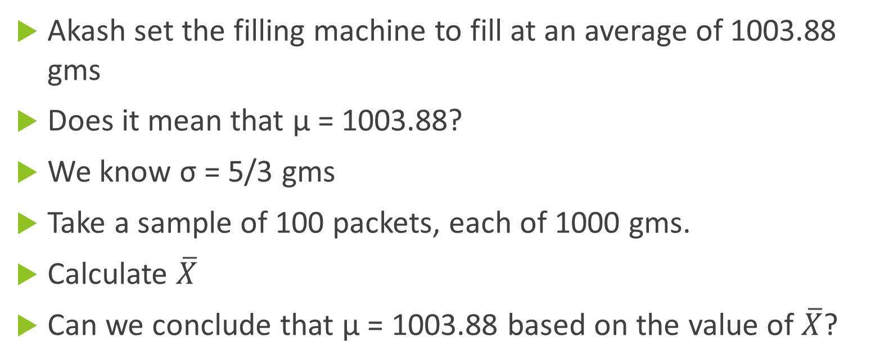
Revisit to “How Much to pack?”
Akash set the filling machine to fill at an average of 1003.88 gms
Does it mean that μ = 1003.88?
We know σ = 5/3 gms
Take a sample of 100 packets, each of 1000 gms.
Calculate $\overline{X}$
Can we conclude that μ = 1003.88 based on the value of $\overline{X}$?

Slide 4

Two possibilities
Based on the value of sample mean
Hypothesis is true | Hypothesis is not True
μ = 1003.88 | μ ≠ 1003.88
Conclude that μ = 1003.88
BAD Decision Type II Error
GOOD Decision
BAD Decision Type II Error Prob = β
BAD Decision
Two More Possibilities
Based on the value of $\overline{X}$
Conclude that μ ≠1003.88
BAD Decision Type I Error
BAD Decision Type I Error Prob = α
GOOD Decision
BAD Decision
Both α and β are conditional probabilities!

Slide 5

Distribution of Sample Mean|μ = 1003.88
Based on the value of sample mean
Hypothesis is true
μ = 1003.88
$$σ_{\overline{X}}= \frac{σ}{\sqrt{n}}=\frac{5}{3×10}$$
Conclude that μ = 1003.88
GOOD Decision
Conclude that μ ≠1003.88
BAD Decision Type I Error Prob = α

Slide 6

Test (If the Hypothesis is True)
α = 0.05
$$σ_{\overline{X}}= \frac{σ}{\sqrt{n}}=\frac{5}{3×10}$$
Z = 1.96
1003.55
LL = 1003.88 – 1.96*5/30= 1003.55
1004.21
UL = 1003.88 + 1.96*5/30=1004.21
There is a 95% chance that sample mean will lie between 1003.55 and 1004.21
0.025
0.025

Slide 7
Calculation of Type II Error (probability)
We are looking at the Second Column
Based on the value of sample mean
Hypothesis is not True
1003.55
1004.21
μ ≠ 1003.88
Conclude that μ = 1003.88
BAD Decision Type II Error Prob = β
0.5713
Conclude that μ ≠1003.88
GOOD Decision
We do not know the value of μ
Our Decision Rule:
“Accept” if sample mean is between 1003.55 and 1004.21
Say, µ = 1004.18

Slide 8
Consider μ = 1003.48
1003.55
1004.21
0.3299

Slide 9
OC Curve and Power Curve
Α = 0.05 and n = 100
µ | β | 1 - β
1003.18 | 0.0125 | 0.9875
1003.28 | 0.0505 | 0.9495
1003.38 | 0.1492 | 0.8508
1003.48 | 0.3299 | 0.6701
1003.58 | 0.5635 | 0.4365
1003.68 | 0.7756 | 0.2244
1003.78 | 0.9078 | 0.0922
1003.88 | 0.9500 | 0.0500
1003.98 | 0.9078 | 0.0922
1004.08 | 0.7756 | 0.2244
1004.18 | 0.5635 | 0.4365
1004.28 | 0.3299 | 0.6701
1004.38 | 0.1492 | 0.8508
1004.48 | 0.0505 | 0.9495
1004.58 | 0.0125 | 0.9875

Slide 10
OC Curve and Power Curve
Α = 0.05 and n = 1000
μ | β | 1 - β
1003.18 | 0.0000 | 1.0000
1003.28 | 0.0000 | 1.0000
1003.38 | 0.0000 | 1.0000
1003.48 | 0.0000 | 1.0000
1003.58 | 0.0001 | 0.9999
1003.68 | 0.0333 | 0.9667
1003.78 | 0.5249 | 0.4751
1003.88 | 0.9500 | 0.0500
1003.98 | 0.5249 | 0.4751
1004.08 | 0.0333 | 0.9667
1004.18 | 0.0001 | 0.9999
1004.28 | 0.0000 | 1.0000
1004.38 | 0.0000 | 1.0000
1004.48 | 0.0000 | 1.0000
1004.58 | 0.0000 | 1.0000

Slide 11
Homework
Calculate β and 1 – β for α = 0.10 and 0.01
with n =100 and n= 1000.
Draw the OC curve and Power Curve

Slide 12
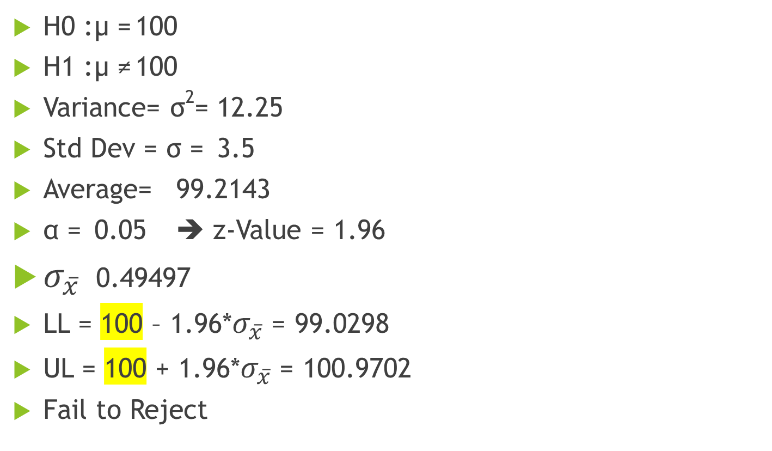
Case: Is Medworld Cheating?
H0 : µ = 100
H1 : µ ≠ 100
Variance= σ²= 12.25
Std Dev = σ = 3.5
Average= 99.2143
α = 0.05 ➔ z-Value = 1.96
$σ_{\overline{x}}$ 0.49497
LL = 100 – 1.96*$σ_{\overline{x}}$= 99.0298
UL = 100 + 1.96*$σ_{\overline{x}}$= 100.9702
Fail to Reject
Sample mean lies between the two limits

Slide 13
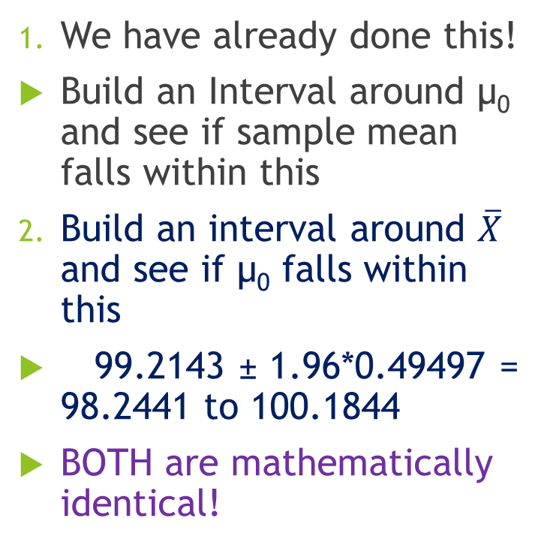


Three other ways to Test the Hypothesis
We have already done this!
Build an Interval around µ₀ and see if sample mean falls within this
Build an interval around $\overline{X}$ and see if µ₀ falls within this
99.2143 ± 1.96*0.49497 = 98.2441 to 100.1844
BOTH are mathematically identical!
99.0298
100.9702
$$2×1.96×σ_{\overline{X}}$$
$$2×1.96×σ_{\overline{X}}$$
99.2143

Slide 14
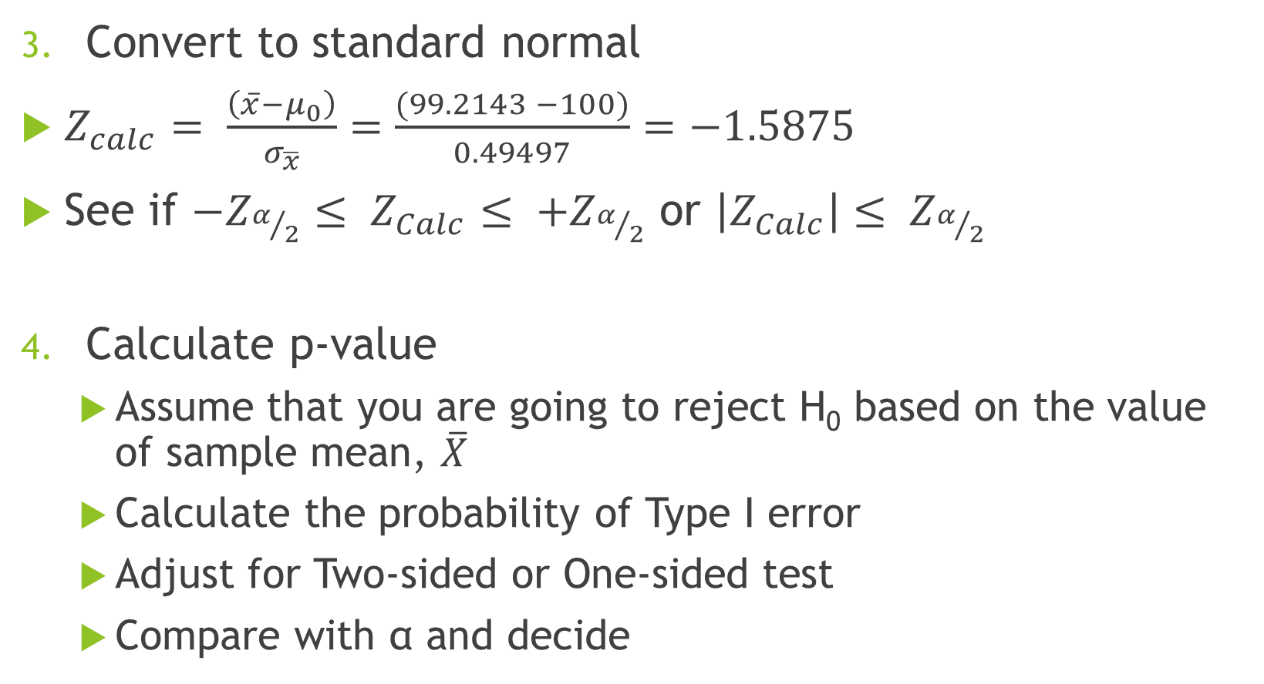
Three other ways (Continued)
Convert to standard normal
$Z_{calc}= \frac{\left(\overline{x}−μ_{0}\right)}{σ_{\overline{x}}}=\frac{(99.2143 −100)}{0.49497}=−1.5875$
See if $−Z_{α/2}≤ Z_{Calc}≤ +Z_{α/2}$ or $\left|Z_{Calc}\right|≤ Z_{α/2}$
Calculate p-value
Assume that you are going to reject H₀ based on the value of sample mean, $\overline{X}$
Calculate the probability of Type I error
Adjust for Two-sided or One-sided test
Compare with α and decide

Slide 15

Calculation of p-value
$\overline{X}=$99.2143

Slide 16
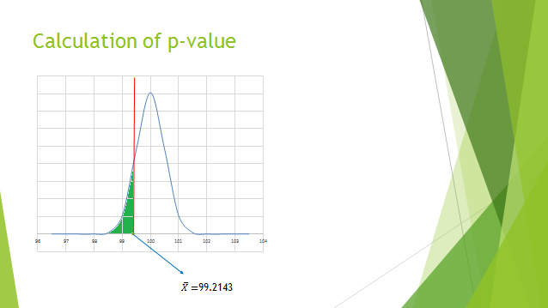
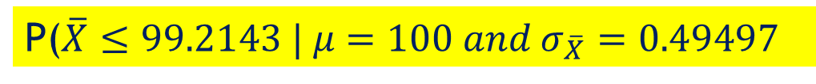
P($\overline{X}≤99.2143 | μ=100 and σ_{\overline{X}}=0.49497$
0.0562
P-value = 0.0562*2=0.1124
Which is greater than 0.05 (α)
Hence do not reject H₀

Slide 17
Hypothesis Test – Step by Step
State the null and alternate hypotheses (with respect to the population parameter)
Set the value of α (level of significance)
Identify the “sample estimator” corresponding to the population parameter
Identify the probability distribution (sampling distribution) of the estimator
Calculate the decision rule (Rejection Region)
Decide on the sample size
Collect data, calculate the estimator and TEST
Draw conclusions

Slide 18
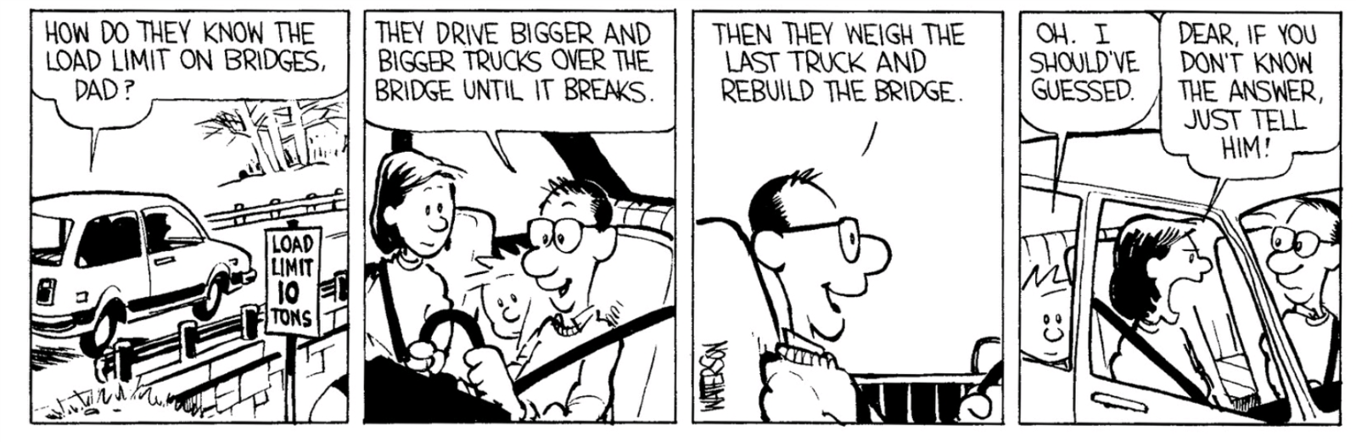
Bending of Belmadi

Slide 19
Bending of Belmadi: Two ways of setting up Null Hypothesis
Method A
Method B
H₀: μ ≥ 87 KIPS
H₁: μ < 87 KIPS
Type I error: Reject H₀ when “it is true” – minimize α
Implication: The bridge is actually safe, but we will ask the contractor to strengthen the bridge!
Unnecessary cost to the contractor
Type II error: Accept H₀ when “it is NOT true” – minimize β
Implication: Bridge is UNSAFE, but we will allow traffic
Loss of life; legal cases
H₀: µ ≤ 87 KIPS
H₁: μ > 87 KIPS
Type I error: Reject H₀ when “it is true” – minimize α
Implication: Bridge is UNSAFE, but we will allow traffic
Loss of life; legal cases
Type II error: Accept H₀ when “it is NOT true” – minimize β
Implication: The bridge is actually safe, but we will ask the contractor to strengthen the bridge!
Unnecessary cost to the contractor

Slide 20

Bending of Belmadi: Calculation of Rejection Regions
Mean= | 87.43
Var= | 42.25
S= | 6.5
 | 1.0833
n = | 36
α value | t-value
0.05 | 1.6896
0.01 | 2.4377
0.005 | 2.7238
0.001 | 3.3400
$S_{\overline{X}}$=
Method A
Method B
α | Cut-off
0.05 | 85.17
0.01 | 84.36
0.005 | 84.05
0.001 | 83.38
α | Cut-off
0.05 | 88.83
0.01 | 89.64
0.005 | 89.95
0.001 | 90.62

Slide 21
Conclusion?

Slide 22
Breaking the Windshields - 1
C
Krishna Kant’s Wind Shields
H₀: µ ≥ 500 psi
H₁: µ < 500 psi
σ = 50 psi
Current Supplier:
µ = 470
Is this an “appropriate Alternate” value for µ for H₁?
α = 0.10
10%

Slide 23
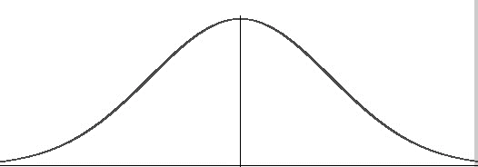


μ
β
μ_{n} > μ
β
$${\overline{X}}_{critical}$$
μ_{n} > μ

Slide 24
Breaking the Windshields – 2
C
Calculation of β
5%

Slide 25
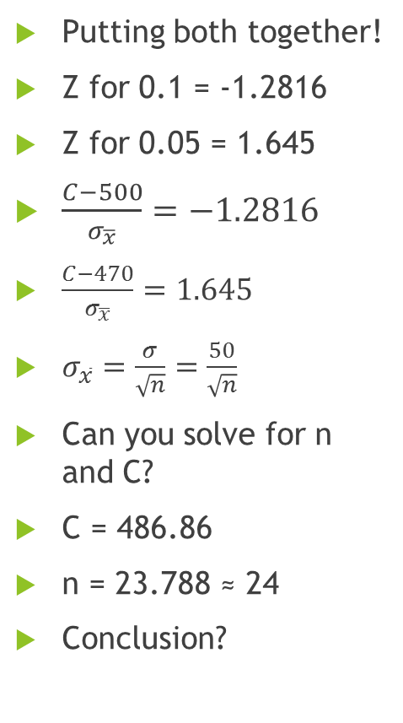
Breaking the Windshields – 3
Putting both together!
Z for 0.1 = -1.2816
Z for 0.05 = 1.645
$\frac{C−500}{σ_{\overline{x}}}=−1.2816$
$\frac{C−470}{σ_{\overline{x}}}=1.645$
$σ_{\overline{x}}=\frac{σ}{\sqrt{n}}=\frac{50}{\sqrt{n}}$
Can you solve for n and C?
C = 486.86
n = 23.788 ≈ 24
Conclusion?
C
10%
5%

Slide 26
Is Medworld Cheating? Data
99.85 | 96.33 | 107.2 | 96.81 | 100.32 | 99.45 | 95.81 | 97.2 | 96.82 | 101.57
98.53 | 97.19 | 96.53 | 103.2 | 95.68 | 97.78 | 106.87 | 104.58 | 101.95 | 103.81
98.43 | 93.06 | 103.69 | 94.98 | 103.26 | 97.63 | 97.09 | 96.85 | 93.36 | 100.08
98.73 | 102.26 | 103.28 | 97.47 | 99.25 | 99.63 | 98.26 | 102.25 | 100.86 | 98.92
95.5 | 100.15 | 99.77 | 101.13 | 97.83 | 98.24 | 98.23 | 98.27 | 100.76 | 100.01
Proportion of tablets with less than 100mg = 0.62

Slide 27
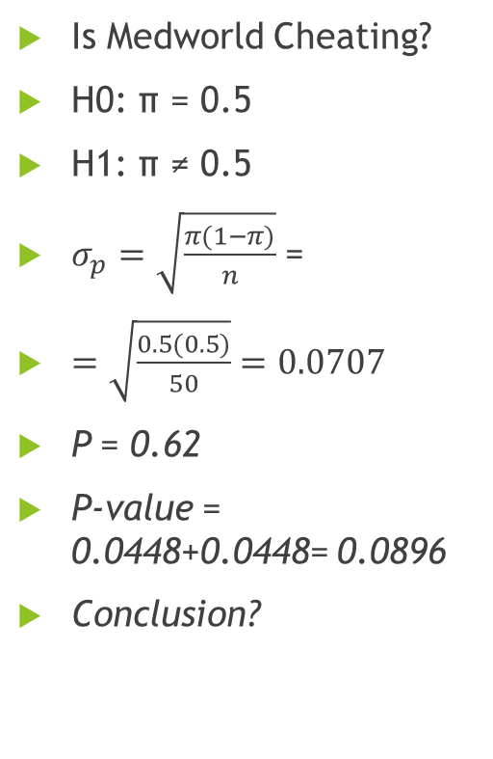
Hypothesis Test – Proportion
Is Medworld Cheating?
H0: π = 0.5
H1: π ≠ 0.5
$σ_{p}=\sqrt{\frac{π(1−π)}{n}}$ =
$=\sqrt{\frac{0.5(0.5)}{50}}=\text{0.0707}$
P = 0.62
P-value = 0.0448+0.0448= 0.0896
Conclusion?
0.0448
0.0448

Slide 28
Questions?
Clarifications?

